Slide 1
Gradient Descent
Boston University CS 506 - Lance Galletti

Slide 2
Logistic Regression Revisited
Given a 2 x 2 grid where each cell a_{ij} can take on one of two colors c₁ and c₂, find a function that can identify the following diagonal pattern:
= c₁ = -1
= c₂ = 1

Slide 3
Logistic Regression Revisited
That is, find f such that
a₀₀ | a₀₁
a₁₀ | a₁₁
c₁ | c₂
c₂ | c₁
✔ if
=
=
(
) =
a₀₀ | a₀₁
a₁₀ | a₁₁
f
✘ otherwise
We can define: ✔ = 1 and ✘ = 0

Slide 4
Logistic Regression Revisited
w₁ | w₂
w₃ | w₄
We can assign weights to each cell

Slide 5
Logistic Regression Revisited
w₁ | w₂
w₃ | w₄
a₀₀ | a₀₁
a₁₀ | a₁₁
= w₁a₀₀

Slide 6
Logistic Regression Revisited
w₁ | w₂
w₃ | w₄
a₀₀ | a₀₁
a₁₀ | a₁₁
= w₁a₀₀ + w₂a₀₁

Slide 7
Logistic Regression Revisited
w₁ | w₂
w₃ | w₄
a₀₀ | a₀₁
a₁₀ | a₁₁
= w₁a₀₀ + w₂a₀₁ + w₃a₁₀

Slide 8
Logistic Regression Revisited
w₁ | w₂
w₃ | w₄
a₀₀ | a₀₁
a₁₀ | a₁₁
= w₁a₀₀ + w₂a₀₁ + w₃a₁₀ + w₄a₁₁

Slide 9
Logistic Regression Revisited
w₁ | w₂
w₃ | w₄
We can assign weights to each cell
such that:
w₁a₀₀ + w₂a₀₁ + w₃a₁₀ + w₄a₁₁ = b if diagonal pattern found
w₁ | w₂
w₃ | w₄
a₀₀ | a₀₁
a₁₀ | a₁₁

Slide 10
Logistic Regression Revisited
For example:
w₁ | w₂
w₃ | w₄
-2 | 2
2 | -2
=
What value b do we get when applied to the diagonal pattern?
-2 | 2
2 | -2
-1 | 1
1 | -1
= ?

Slide 11
Logistic Regression Revisited
Any other pattern will have a value lower:
-2 | 2
2 | -2
-1 | --1
1 | -1
= ?

Slide 12
Logistic Regression Revisited
Equivalently we can decide to move the value b to the left of the equation in order for the weighted sum to reveal a diagonal pattern at 0:
w₁a₀₀ + w₂a₀₁ + w₃a₁₀ + w₄a₁₁ + b = 0 if diagonal pattern found
We could then find a function 𝞂 to apply to the result of this sum in order to make predictions {0, 1}:
𝞂(w₁a₀₀ + w₂a₀₁ + w₃a₁₀ + w₄a₁₁ + b) = 1 if w₁a₀₀ + w₂a₀₁ + w₃a₁₀ + w₄a₁₁ + b = 0 else 0

Slide 13
Logistic Regression Revisited
Suppose we relax our definition of diagonal by having a continuum of colors [c₁, c₂]. This means there will be a continuum of values for our weighted sum to take when a diagonal pattern is found:
w₁a₀₀ + w₂a₀₁ + w₃a₁₀ + w₄a₁₁ + b > 0 if diagonal

Slide 14
Logistic Regression Revisited
Suppose we relax our definition of diagonal by having a continuum of colors [c₁, c₂]. This means there will be a continuum of values for our weighted sum to take when a diagonal pattern is found:
w₁a₀₀ + w₂a₀₁ + w₃a₁₀ + w₄a₁₁ + b > 0 if diagonal
We would like our function to adapt to this vagueness of specification / definition by reflecting an uncertainty in prediction (i.e. predicting probabilities of being diagonal)
𝞂(w₁a₀₀ + w₂a₀₁ + w₃a₁₀ + w₄a₁₁ + b) > 0.5 then diagonal

Slide 15
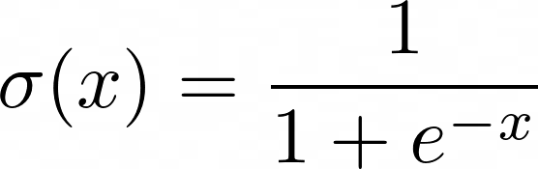
Logistic Regression Revisited
When 𝞂 is the logistic (also called sigmoid) function, this is Logistic Regression.
So for each cell we’re looking to learn a weight w_{i} that makes 𝞂 larger for diagonal patterns. The bias term b lets us account for systemic dimming or brightening of cells (i.e. when the data is not normalized).
.92 .81 .95 .73 .68 .99

Slide 16
Logistic Regression Revisited
a₀₀
a₀₁
𝝨w_{i}a_{i}
a₀₀ | a₀₁
a₁₀ | a₁₁
𝞂
proba
a₁₀
a₁₁
where

Slide 17
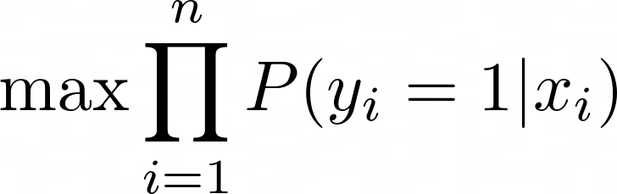

Logistic Regression Revisited
Recall that logistic regression is looking for weights and a bias that maximizes the probability of having seen the data we saw:

Slide 18
Gradient Descent (intuition)
There is no closed form solution to finding the extrema of this cost function. We can however use an iterative process by which we increment w and b gradually toward some minimum (most likely local).
Goal: find a sequence of w_{i}’s (and b’s) that converge toward a minimum.

Slide 19
Gradient Descent (intuition)
Consider a random weight w₀. What happens to Cost(w₀) as you nudge w₀ slightly?
+
+
+
-
Cost(w₀)
+
-
-
-
Clearly this is the best nudge to give w₀ to improve our Cost

Slide 20
Gradient Descent (intuition)
As such we can define the following sequence:
w₁ = best nudge to w₀
w₂ = best nudge to w₁
…
Until we reach w_{t} that looks like this:
At this point we can stop updating w. Why?
+
+
+
+
Cost(w_{t})
+
+
+
+

Slide 21
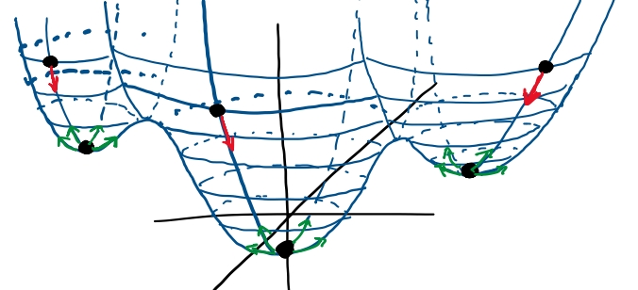
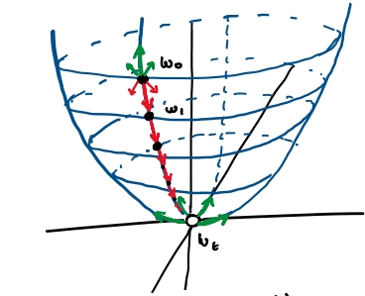
Gradient Descent (intuition)

Slide 22
Gradient Descent (intuition)
How can we know how much to nudge and in what direction?

Slide 23

Gradients
Intuitively the best nudge should be in the direction of the largest rate of change (steepness) of the function.
Rate of change -> think derivatives

Slide 24
Gradients
Intuitively the best nudge should be in the direction of the largest rate of change (steepness) of the function.
Rate of change -> think derivatives

Slide 25
Gradients
Intuitively the best nudge should be in the direction of the largest rate of change (steepness) of the function.
Rate of change -> think derivatives

Slide 26
Gradients
Intuitively the best nudge should be in the direction of the largest rate of change (steepness) of the function.
Rate of change -> think derivatives

Slide 27
Gradients
Intuitively the best nudge should be in the direction of the largest rate of change (steepness) of the function.
Rate of change -> think derivatives

Slide 28
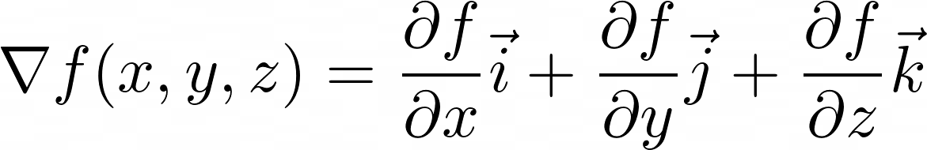
Gradients
Intuitively, the rate of change of a multi-dimensional function should be a combination of the rate change in each dimension. For a 3-dimensional function, the rate of change would be:
j
k
i

Slide 29
Gradients
Example:
f(x) = 3x²-2y
Without even computing derivatives we can see that changes in x create more positive change in f than changes in y.
∇f = 6xi - 2j
This is the gradient of f and can be evaluated at any point (x, y) in the space.

Slide 30
Gradients
f(x) = 3x²-2y , ∇f = 6xi - 2j
Evaluating ∇f at p=(0, 0):
∇f_{p} = 6ᐧ0ᐧi - 2j = -2j
What happens to f as we move 1 unit away from p in the direction of the gradient?
p_{new} = 1ᐧ ∇f_{p} + p = (0, -2)
f(p_{new}) = 3ᐧ0² - 2ᐧ (-2) = 4 > f(p) = 0

Slide 31
Gradients
f(x) = 3x²-2y , ∇f = 6xi - 2j
What happens to f if we move 1 unit away from p in a random direction (not following ∇f)? Say (1,0) = 1i + 0j:
p_{new} = 1ᐧ (1,0) + p = (1, 0)
f(p_{new}) = 3 < 4
Moving p along the gradient will result in the fastest increase in f from p.

Slide 32
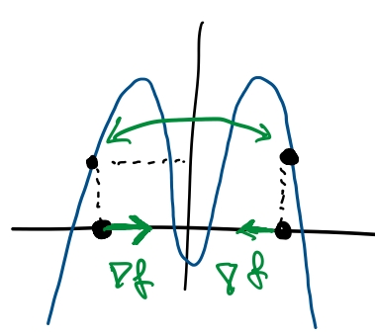
Gradients
However, the gradient expresses the instantaneous rate of change. At p, ∇f_{p} is the steepest but the highest value of f will depend on how many units we step in that direction. If we step too many units away, the instantaneous change in f is no longer representative of what values f will take.
Example:

Slide 33
Gradient Descent
Given a “smooth” function f for which there exists no closed form solution for finding its maximum, we can find a local maximum through the following steps:
Define a step size 𝛂 (tuning parameter)
Initialize p to be random
p_{new} = 𝛂 ∇f_{p} + p
p 🠄 p_{new}
Repeat 3 & 4 until p ~ p_{new}
To find a local minimum, just use -∇f_{p}

Slide 34
Gradient Descent
Notes about 𝛂:
If 𝛂 is too large, GD may overshoot the maximum, take a long time to or never be able to converge
If 𝛂 is too small, GD may take too long to converge

Slide 35
Gradient Descent
Let’s apply this to our diagonal problem to find the weights and bias for logistic regression.
Assume we have the following dataset:
✔
[0 1 1 0]^{T}

Slide 36
Gradient Descent
Recall:
=

Slide 37

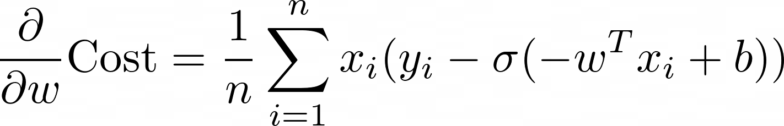
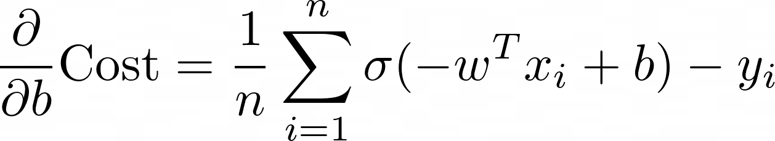
Gradient Descent
We need to compute ∇Cost(w, b):

Slide 38
Gradient Descent
= [0 1 1 0]^{T}
1. Start with random w and b:
w = [0 0 0 0]^{T} , b = 0
Note: 𝞂(0) = 0.5

Slide 39
Gradient Descent
2. Compute the Cost(w, b)
Cost([0 0 0 0]^{T} , 0) = -1 log(𝞂(0)) = -log(0.5)

Slide 40
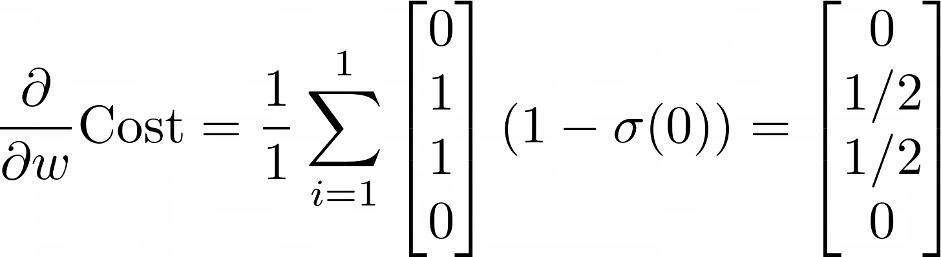
Gradient Descent
= [0 1 1 0]^{T}
3. Compute the gradient ∇Cost at (w, b)
Recall we only have one data point

Slide 41
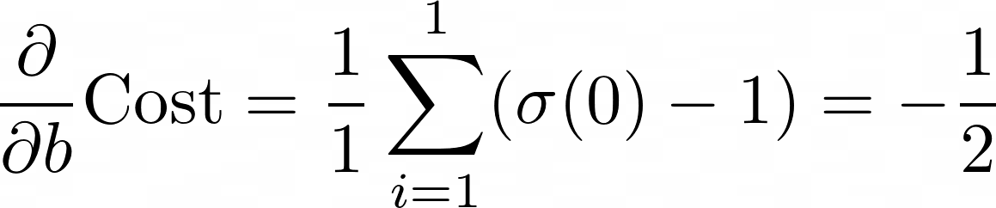
Gradient Descent
= [0 1 1 0]^{T}
3. Compute the gradient ∇Cost at (w, b)
Recall we only have one data point

Slide 42
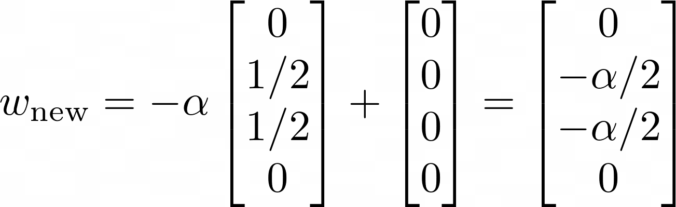
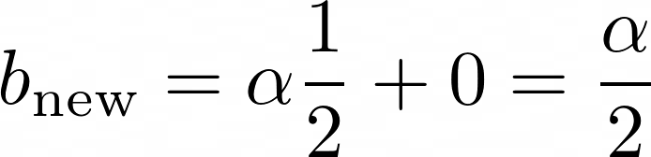
Gradient Descent
4. Adjust w & b by taking 𝛂 steps in the direction of -∇Cost_{(w, b)}

Slide 43
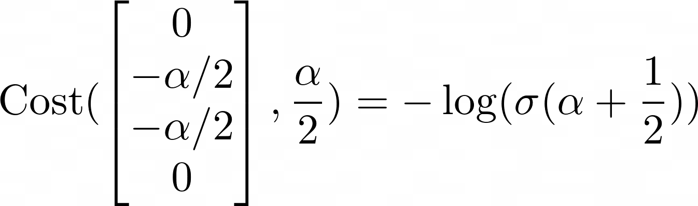
Gradient Descent
5. Compute the updated Cost
For what values of 𝛂 is the Cost reduced?

Slide 44
Stochastic Gradient Descent
Recall the Cost is computed for the entire dataset. This has some limitations:
It’s expensive to run
The result we get depends only on the initial starting point

Slide 45
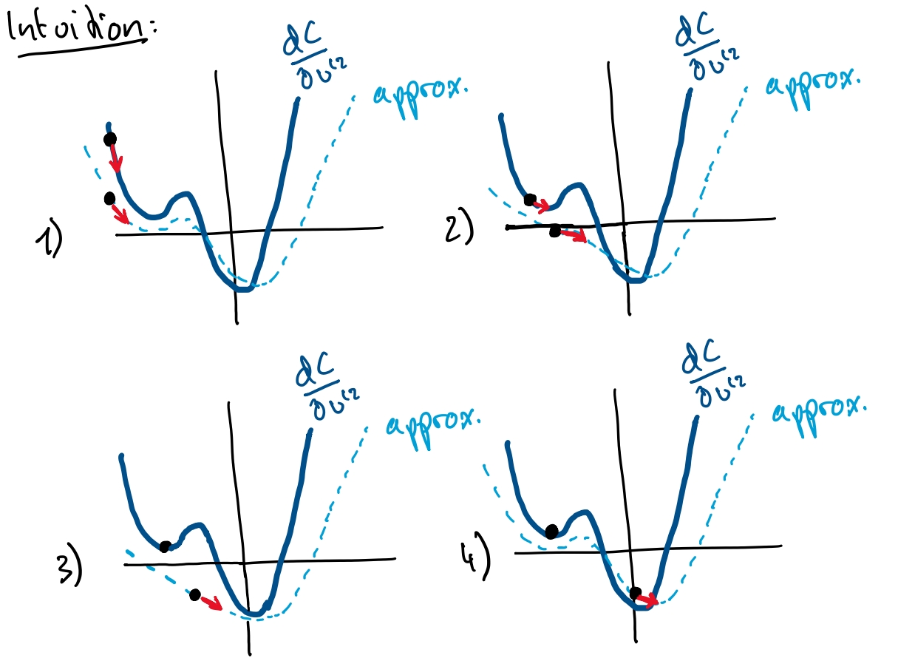
Stochastic Gradient Descent
Goal: Approximate the gradient of the Cost using a sample of the data (batch)

Slide 46
Note
The magnitude of ∇f_{p} depends on p. A p gets closer to the min / max, the size of ∇f_{p} decreases.
This also means that points p that contain more “information” have larger gradients. So the order with which this process is exposed to examples matters.

